Slide 1
Routing Protocol: EIGRP & OSPF
Course Code: COE 3206
Course Title: Computer Networks
Dept. of Computer Science
Faculty of Science and Technology
Lecturer No: | 10 | Week No: | 11 | Semester: | Fall 23-24
Lecturer: | Dr. Md Mehedi Hasan; mmhasan@aiub.edu

Slide 2
Lecture Outline
Introduction
Metric
Neighbor Discovery
EIGRP Tables
EIGRP Tables
EIGRP Configuration

Slide 3

Routing Protocol: EIGRP

Slide 4
RIP vs EIGRP
 | RIP | EIGRP
1 | It support maximum 15 routers in the network. 16 router is unreachable. | It supports maximum 255 routers in the network. However, the default is 100 routers. (highly scalable)
2 | Slow convergence | Fast convergence due to feasible successor
3 | In RIP routing protocol, we cannot create a separate administrative boundary in the network. | In EIGRP routing protocol we can create a separate administrative boundary in the network with the help of autonomous system No. Less routing Table exchange is required.
4 | It calculates the metric In terms of Hop Count from source network to destination network. | It calculates the metric In terms of bandwidth and delay (default).
5 | RIP works on Bellman Ford algorithm. | EIGRP works on DUAL(Diffusing Update Algorithm) Algorithm.
6 | It only maintains the best route to each destination. | It maintains the best route and some other alternative routes for each destination.
7 | It is basically use for smaller size organization. | It is basically use for medium to lager size organization in the network [1].

Slide 5
Metric
Combination of different factors
Bandwidth
Delay
Load
Reliability
Default

Slide 6
Bandwidth
No. of bits that can be sent over a link (kbps)
Depends on interface type
Use bandwidth <1-10,000,000> command to set bandwidth in kbps
This is not real bandwidth; real bandwidth depends on clock rate
The bandwidth command only influence route selection by routing protocol
If no bandwidth is set, the default bandwidth of an interface is considered
Calculated as the lowest bandwidth among all links in a route

Slide 7
Bandwidth
Table II Default bandwidth and delay
Interface | Bandwdith | Delay (microseconds)
Serial (T1) | 1544 Kbps | 20,000
Ethernet | 10 Mbps | 1000
Fast Ethernet | 100 Mbps | 100
Gigbit Ethernet | 1000 Mbps | 10
10 Gigbit Ethernet | 10 Gbps | 10

Slide 8
Delay
Delay is a measure of the time for a packet to reach its destination over a route (In theory)
In practice, it is a constant set by the network engineer
To set delay for an interface, use delay <value> command
The value can be anything between 10 to 167,772,140 microseconds
If it is not set, the default value (Table II) of each interface comes into effect
Calculated as sum of delays in exit interfaces of all routers in a route.

Slide 9
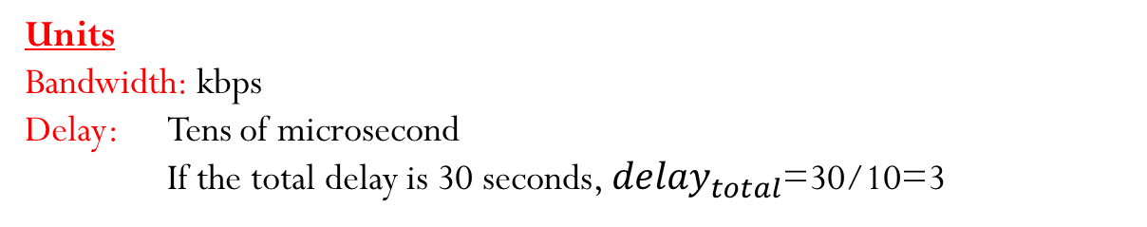
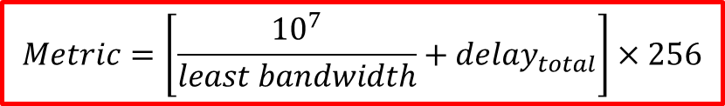
Metric Calculation
$$Metric=\left[\frac{{10}^{7}}{least bandwidth}+{delay}_{total}\right]×256$$
Units
Bandwidth: kbps
Delay: Tens of microsecond
If the total delay is 30 seconds, ${delay}_{total}$=30/10=3

Slide 10
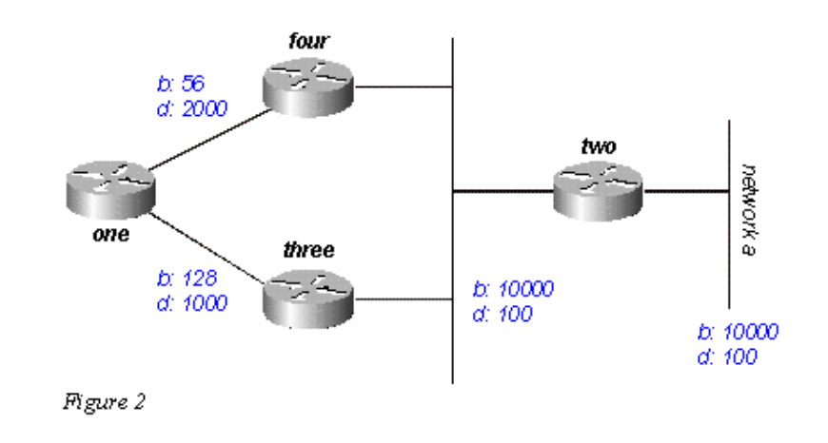





Metric Calculation
$$Metric=\left[\frac{{10}^{7}}{least bandwidth}+{delay}_{total}\right]×256$$
Route: 1-4-2-B
$$Least BW=56 kbps$$
$$Total delay=100/10+100/10+2000/10=220$$
$Metric=\left[\frac{{10}^{7}}{56}+220\right]×256=45770496$*
Route: 1-3-2-B
$$Least BW=128 kbps$$
$$Total delay=100/10+100/10+1000/10=120$$
$Metric=\left[\frac{{10}^{7}}{128}+120\right]×256=$20030720
Fig. 1 A sample network [2]
Perform rounding in every steps of calculation

Slide 11
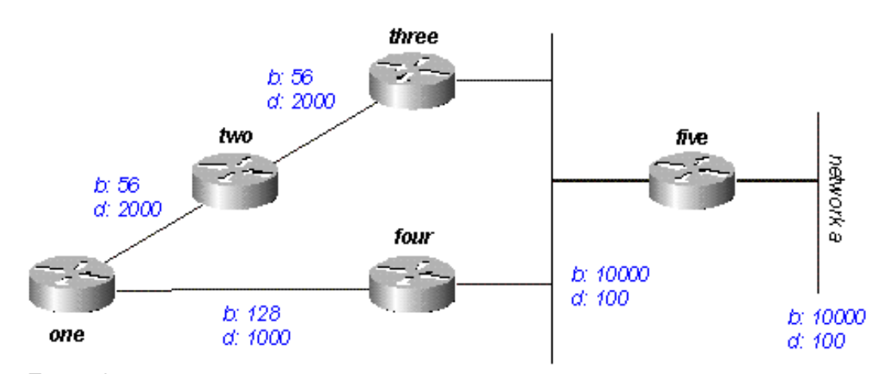
Exercise
Calculate metric for all possible routes from router ONE to network A
Fig. 2 A sample network [2]

Slide 12
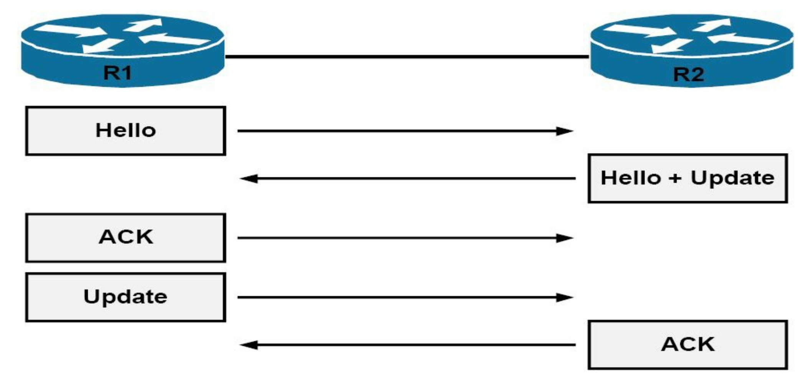
Neighbor Discovery
Hello, how are you? Can we be neighbors?
My AS No. and K-values are so and so….
Dest.
224.0.0.10
10.1.1.1
10.1.1.2
Dest.
10.1.1.1
Our AS no. and k-values have matched?
Here is my full routing table.
Dest.
10.1.1.2
I have received our routing table. Thanks
Dest.
10.1.1.2
Here is my full routing table.
Dest.
10.1.1.1
I have received our routing table. Thanks
Fig. 3 Neighbor discovery [3]

Slide 13
Neighbor Maintenance
In neighbor discovery process, full routing table is sent
Otherwise, only the change in routing table is sent
After a neighbor discovery, the Hello packet is sent in every 5 second to know if the neighbor is still alive
If a router does not receive any Hello packet from a neighbor within 15 seconds (called hold time), the neighbor is considered dead.
For low-bandwidth link (e.g., T1), the periods are 60 sec and 180 sec.

Slide 14
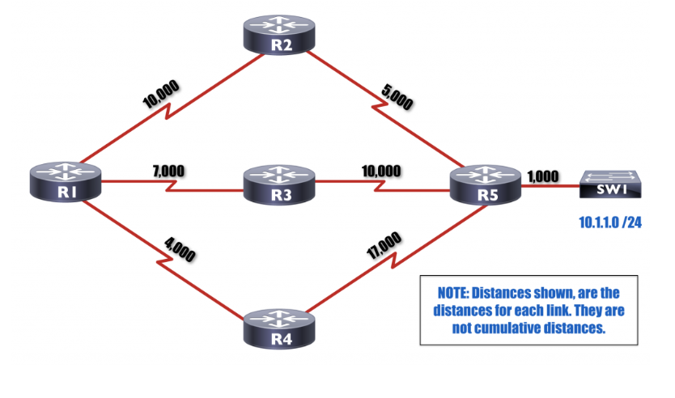
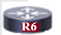

EIGRP Tables
Feasibility condition: reported distance must
be less than the feasible distance through the successor
Reported distance:
Distance advertised from neighbor
as the distance between the
Neighbor and the destination.
1000
3000
Feasible distance (FD):
Sum of Reported distance and
distance between the router and
the neighbor which reports
the distance.
A is the route whose
reported distance is less than the
feasible distance of the best path.

Slide 15
EIGRP Tables
Neighbor Table
EIGRP shares routing information only with neighbors. To know who the neighbors are, it uses neighbor table. When a new neighbor is discovered, EIGRP would add its address and interface on which neighbor is connected in neighbor table [4].
Topology Table
Stores all feasible successors along with the successor (best route) for each destination network. EIGRP can store up to 32 feasible successors.
Routing Table
EIGRP stores single best route for each destination in this table. Router uses this table to forward the packet.

Slide 16
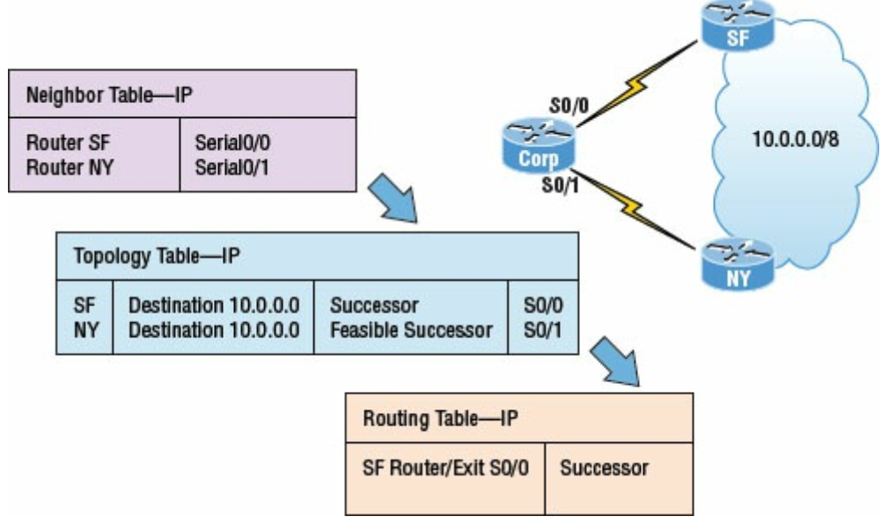
EIGRP Tables: Example

Slide 17
Routing Protocol: OSPF

Slide 18
EIGRP VS OSPF
Topic sub heading..
 | EIGRP | OSPF
1 | It supports maximum 255 routers in the network. However, the default is 100 routers. (highly scalable) | Supports unlimited number of routers
2 | Fast convergence due to feasible successor | Fastest convergence speed due to the area concept
3 | Cisco proprietary protocol and can be implemented only in Cisco routers. | Open standard protocol and can be implement in any router.
4 | It calculates the metric In terms of bandwidth and delay (default). | It calculates the metric In terms of bandwidth only.
5 | EIGRP works on DUAL(Diffusing Update Algorithm) Algorithm. | EIGRP works on Dijkstra Algorithm.
6 | It maintains the best route and some other alternative routes for each destination. | It maintains the best route in routing table and all routes in database table.
7 | It is basically use for medium to lager size organization in the network [1]. | It is basically use for lager size organization in the network [1].
8 | Administrative distance 90 | Administrative distance 110
9 | Easy to implement | The implementation is complicated

Slide 19
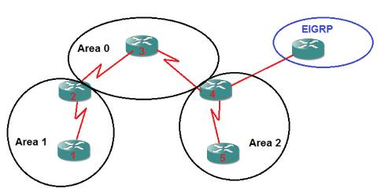
OSPF Area
An autonomous system (AS) is
divided into one or more area.
Each area is given an area ID
An AS must have an area having
ID 0 (zero) for multi-area OSPF.
Such area is called backbone area.
All areas of an AS must be
connected to the backbone area.
A router in an area exchanges routing
information with the routers of its
area only (by default)
Autonomous
system 20
Autonomous system 10
Fig. 1 Autonomous systems and area

Slide 20
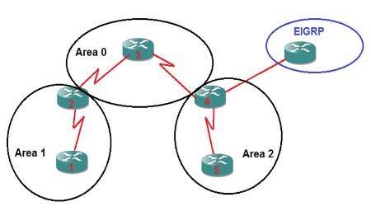
OSPF Routers
Internal Router (IR): The router for which all its interface belong to one area. Router 1 and Router 5.
Area Border Router (ABRs):The router that contains interfaces in more than one area. Router 2 and Router 4
Backbone Router: The router that has all or at least one interface in Area 0. Router 3, Router 2 and Router 4.
Autonomous
system 20
Autonomous system 10
Fig. 1 Autonomous systems and area
Autonomous System Boundary Router (ASBR): The routers with connection to a separate autonomous system. R4 in the example is connected to EIGRP [4].

Slide 21
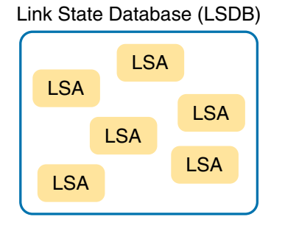
OSPF Data Structure & Packets
Link state advertisement (LSA)
A data structure with some specific information about the networks [2].
Depending on its type, it holds information about
a router’s interfaces,
all routers attached to network,
summary routing information of an area,
all routers of an AS.
Link state database (LSDB)
A collection of all LSAs known to a router
In a convergent network, all routers of a network
have the same LSDB.
Fig. 2 LSA & LSDB relationship

Slide 22
OSPF Data Structure & Packets
Hello
Used to build and maintain neighbor relationships.
DBD – Database Description
List of LSAs contained in a LSDB. This packet type is circulated when two routers are initially exchanging their link-state databases.
Link State Request (LSR)
Used to request complete information about a link learned from another router.
Link State Update (LSU)
Used to send one or LSA(s)
Links State Acknowledgement (LSAck)
Used to acknowledge the reception of an LSA

Slide 23
Neighbor Discovery
Parameters need to be identical for two routers to become neighbors
Network mask—net mask of the sending router
Subnet number —derived using the subnet mask and each router’s interface Internet Protocol (IP) address
Area ID—area ID of the sending interface
Hello interval—how often Hello packets are transmitted
Dead interval—how long to wait for Hello packets before terminating neighbor
Authentication type and password—optional
Stub area flag—specifies the type of stub area, if applicable [3]
Hello packet contains all these information

Slide 24
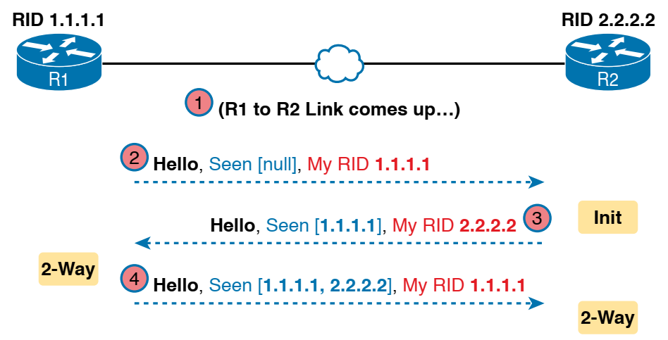
Neighbor Discovery
Example:
The scenario begins with the link down, so the routers have no knowledge of each other as OSPF neighbors
Link between R1 and R2 comes up
R1 sends the first Hello to multicast IP address 224. 0.0.5, so R2 learns of the existence of R1 as an OSPF router. At that point, R2 lists R1 as a neighbor, with an interim beginning state of init.
Fig. 3 Neighbor discovery
R2 sends back a Hello which tells R1 that R2 exists, and it allows R1 to move through the init state and quickly to a 2-way state.
R2 receives the next Hello from R1, and R2 can also move to a 2-way state [2]

Slide 25
Router ID
32-bit unique dotted decimal number
Start
Yes
Manually configured?
Manually configured RID
No
Yes
Loopback interface configured?
RID is the highest IP address
among the loopback interfaces
No
RID is the highest IP address
among the physical interfaces
Stop
Fig. 4 Flow chart of Router ID selection

Slide 26
DR and BDR
Point-to-point network: A network in an area connecting only two routers directly.
Broadcast network: A network in an area connecting more than two routers
Designated router (DR):
In a broadcast network, a router with the highest priority.
If the priorities tie, the router has the highest RID (Router ID)
All database exchange is done via DR
Backup Designated router (BDR)
In a broadcast network, a router with the second highest priority.
If the priorities tie, the router having the second-highest RID
If the DR fails, the BDR takes over.
DROTHER: The router which is neither DR nor BDR [2]

Slide 27
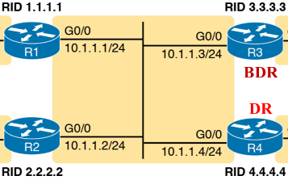
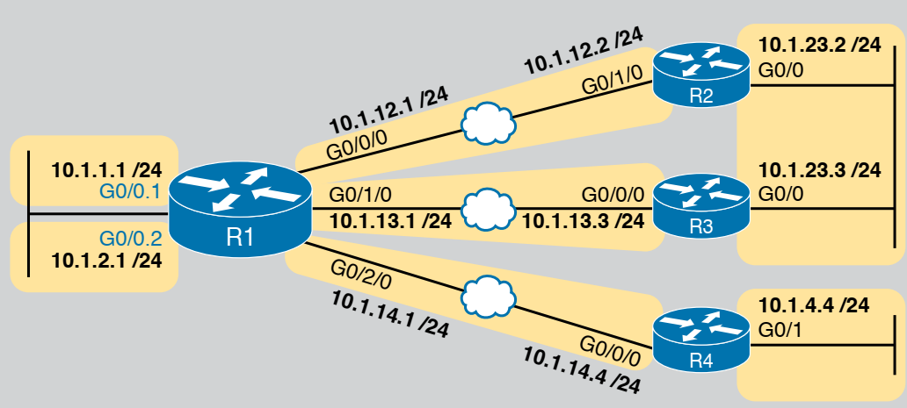
DR and BDR
Fig. 5 point-to-point network
Fig. 6 Broadcast network , DR and BDR
election

Slide 28
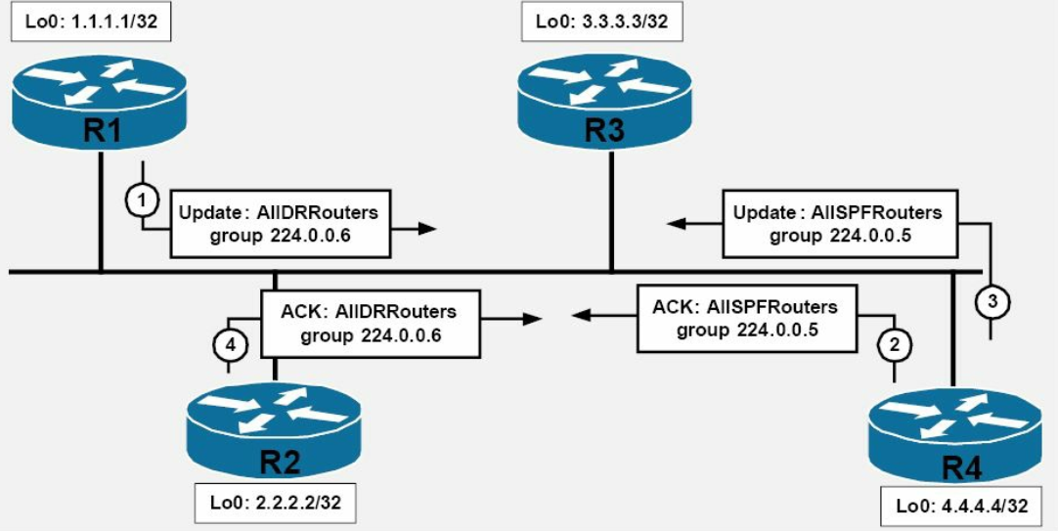
DR and BDR
Fig. 7 Illustration of update exchange through DR and BDR

Slide 29
Wildcard Mask
Used to specify a range of network addresses.
Inverted subnet mask
Used in EIGRP, OSPF and Access-List.
How to get wildcard mask of an IP address?
Subtract the subnet mask from 255.255.255.255
What does each bit of a wildcard mask mean?
0 : All IP address in the range must match the bit
1 : Different IP address in the range can have different value in the bit position

Slide 30
Wildcard Mask
Only 192.168.3.0
All bits must match.
WCM: All bits 0. (00000000.00000000.00000000.00000000)
WCM: 0.0.0.0
IP address range: 192.168.3.0 to 192.168.3.255
Match first three block (24 bits) and fourth block can take any value
WCM: 0.0.0.255
IP address range: 192.168.3.4 to 192.168.3.13
First 28 bits same.
Match first 28 bits; make them all zero
Make rest of the bits 1
11000000.10101000.00000011.00000100
11000000.10101000.00000011.00001101
00000000.0000000.00000000.00001111
WCM: 0.0.0.15
Actual IP range: 192.168.3.0 to 192.168.3.15 under WCM: 0.0.0.15

Slide 31
References
[1] Computer Networking Class, https://computernetworkingclass.blogspot.com...
/2016/08/comparison-between-rip-eigrp-igrp-and.html, [Accessed: April. 27, 2020].
[2] Cisco, “https://www.cisco.com/c/en/us/support/docs/ip/enhanced-interior...
-gateway-routing-protocol-eigrp/16406-eigrp-toc.html, [Accessed: April. 27, 2020].
[3] P. Browning, F. Tafa, D. Gheorghe, and D. Barinic, Cisco CCNA in 60 Days,
Reality Press Ltd., UK, 2014, pp. 581
[4] Computer Networking Notes, https://www.computernetworkingnotes.com/ccna...
-study-guide/eigrp-tutorial-basic-concept-explained.html, [Accessed: April. 27, 2020].

Slide 32
Recommended Books
Official Cert Guide CCNA 200-301 , vol. 1, W. Odom, Cisco Press, First Edition, 2019, USA.
CCNA Routing and Switching, T. Lammle, John Wily & Sons, Second Edition, 2016, USA.

